Slide 1
Important Note Regarding This Microsoft PowerPoint Presentation
* Do not include this slide in your presentation *
This slide deck has been intentionally provided with very limited graphics and formatting to simplify content integration into your own preferred PowerPoint themes and styles.

Slide 2
Security Development Lifecycle (SDL) Field Content
SQL Injection (Level 200)

Slide 3
Agenda
Overview of the Microsoft SDL
SQL Injection Overview
Preventing SQL Injection Vulnerabilities with the Microsoft SDL

Slide 4

Microsoft Security Development Lifecycle (SDL)
Training
Requirem-ents
Design
Implemen-tation
Verification
Release
Response
Delivering secure software requires:
Executive commitment → SDL a mandatory policy at Microsoft since 2004
Education
Technology and Process
Accountability
Ongoing Process Improvements → 6 month cycle

Slide 5
SQL Injection Overview
SQL Injection: Can occur when unvalidated data is used to construct dynamic SQL statements that are later executed by a database
Allows malicious users to control SQL statement execution flow
Manifests due to:
Improper input validation
Dynamic construction of SQL statements without the use of type-safe parameters
Use of over-privileged database logins

Slide 6
SQL Injection Example
SELECT * FROM ShipmentOrders
WHERE ID = ‘<ID_ENTERED_BY_USER>’;
INPUT #1: ID = 1000
Database Executes:
SELECT * FROM ShipmentOrders WHERE ID = ‘1000’;
INPUT #2: ID = 1000’; DROP TABLE ShipmentOrders;--
Database Executes:
SELECT * FROM ShipmentOrders WHERE ID = ‘1000’;
DROP TABLE ShipmentOrders;--’
INPUT #3: ID = 1000’; exec xp_cmdshell <any_command>;--
Database Executes:
SELECT * FROM ShipmentOrders WHERE ID = ‘1000’;
exec xp_cmdshell <any_command>;--’

Slide 7
SQL Injection in the News
March 2006: Indian government tourism site was found to be vulnerable to SQL injection attacks
Web Application Security Consortium, March 29, 2006
August 2007: United Nations website was defaced using a SQL injection attack
Computerworld, August 17, 2007
January 2008: Mass SQL injection attack occurred against tens of thousands of government, academic, and private sector systems
Computerworld, August 8, 2008

Slide 8
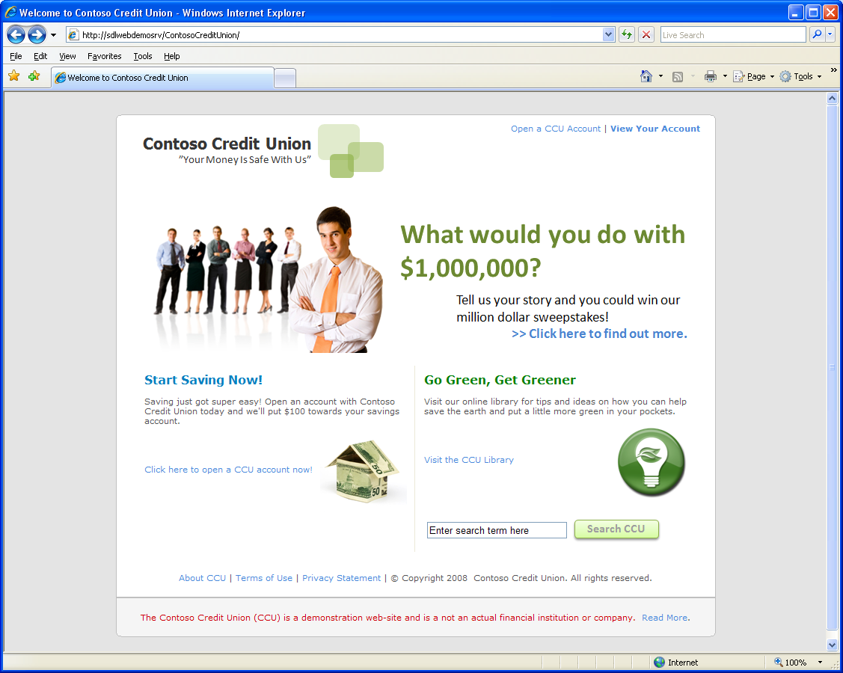
SQL Injection Demonstration: The Contoso Credit Union

Slide 9
Common SQL Injection Myths
SQL injection applies only to applications that use Microsoft SQL Server
SQL injection applies only to Web-based applications
SQL injection can be remedied by using transport security protocols, such as SSL and IPSec
SQL injection only applies to non-authenticated users

Slide 10
Preventing SQL Injection with the Microsoft SDL
Validate input
Use SQL parameterized queries
Use stored procedures
Do not use “exec @sql” construct
Use SQL Execute-Only permission

Slide 11
Using Parameterized Queries to Prevent SQL Injection Attacks
String sqlQuery_CheckIfUserAlreadyEntered =
String.Format("SELECT * FROM [Promotions_MillionDollarSweepstakes] WHERE Email = '{0}'", EmailTextBox.Text);
SqlCommand sqlCmd_CheckIfEmailExists = new SqlCommand(sqlQuery_CheckIfUserAlreadyEntered, new SqlConnection(connectionString));
String sqlQuery_CheckIfUserAlreadyEntered =
"SELECT * FROM [Promotions_MillionDollarSweepstakes] WHERE Email = @pEmail”;
SqlParameter pEmail = new SqlParameter(“@pEmail", SqlDbType.NVarChar,250);
pEmail.Value = EmailTextBox.Text;
SqlCommand sqlCmd_CheckIfEmailExists = new SqlCommand(sqlQuery_CheckIfUserAlreadyEntered, new SqlConnection(connectionString));
sqlCmd_CheckIfEmailExists.Parameters.Add(pEmail);

Slide 12
SQL Injection Code Scanning Tools
Any code, developed in any language, that accesses any type of database using a dynamically built SQL statement is suspect for SQL injection
Microsoft Tool | Applies To
Microsoft FxCop | .NET Framework languages
Microsoft Visual Studio Code Analysis Feature (/analyze) | .NET Framework languages
Microsoft Source Code Analyzer for SQL Injection (in ASP code) | Legacy ASP Code

Slide 13
Conclusion
Overview of the Microsoft SDL
Overview of SQL injection vulnerabilities
Preventing SQL injection vulnerabilities with the Microsoft SDL

Slide 14
Appendix

Slide 15


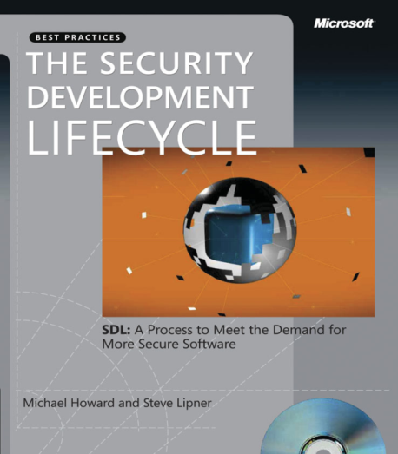


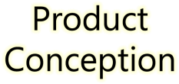
































Microsoft Security Development Lifecycle (SDL)
SDL Book:
http://www.microsoft.com/mspress/books/8753.aspx
Official SDL Web Site: http://www.microsoft.com/sdl

Slide 16
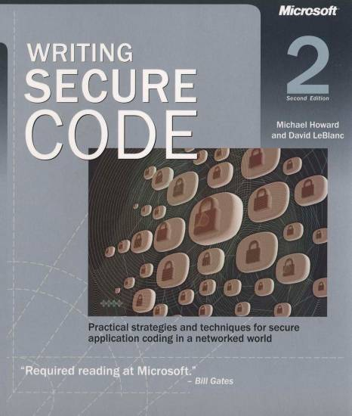
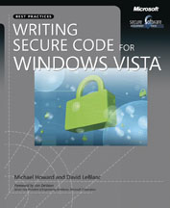
Microsoft Writing Secure Code Book Series
Writing Secure Code,
2nd Edition:
http://www.microsoft.com/mspress/books/5957.aspx
Writing Secure Code for Windows Vista:
http://www.microsoft.com/mspress/books/10723.aspx

Slide 17
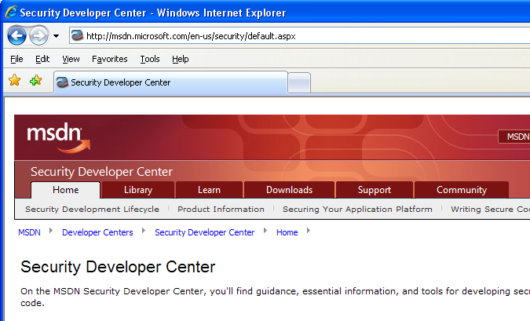

Microsoft Developer Network (MSDN) Security Developer Center
Official Web site: http://msdn.microsoft.com/security

Slide 18
Secure Development Blogs
The Microsoft Security Development Lifecycle (SDL) Blog: http://blogs.msdn.com/sdl
Michael Howard’s Blog: http://blogs.msdn.com/michael_howard

Slide 19
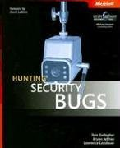
Microsoft Hunting Security Bugs
Hunting Security Bugs:
http://www.microsoft.com/mspress/books/8485.aspx

Slide 20
Additional SDL Training Content
Secure Design Principles
Secure Implementation Principles
Secure Verification Principles
SQL Injection Vulnerabilities
Cross-Site Scripting Vulnerabilities
Buffer Overflow Vulnerabilities

